Slide 1
CRYPTO
CURRENCY
PREDICTION

Slide 2

The Problem Statement
To predict Cryptocurrency prices as liquidity is very high and investor losing lot of money in wrong currency.

Slide 3

Objective: Our project is to forecast the bitcoin price with improved efﬁciency using deep learning models and minimizing the risks for investors as well as policy-makers
Scope of the Project: Accurate predictions can assist cryptocurrency investors towards right investing decisions and lead to potential increased profits.

Slide 4

The solution
To the best of our knowledge, our target is to implement the efficient deep learning-based prediction models specifically long short-term memory (LSTM) and gated recurrent unit (GRU) to handle the price volatility of bitcoin and to obtain high accuracy. . The study reveals that the GRU model is the better mechanism for time series cryptocurrency prediction. d takes lower compilation time. LSTM and GRU models are more capable of recognizing long-term dependencies. In this study, we have only compared to basic deep learning-based models, i.e., LSTM and GRU.

Slide 5
The solution
However, it needs to investigate further to enhance the accuracy of the deep learning-based prediction models by considering different parameters in addition to the previous one. Features such as political system, public relations, and market policy of a country can affect and determine the price volatility of cryptocurrency. In our study, we will apply model to cryptocurrencies such as ripple, ethereum, lite coin, and others. We will enhance the model by applying on these cryptocurrencies so the model becomes a stable one.

Slide 6
Software Requirement
Tenser flow
LSTM Model
DATA SET
Keras
Streamlite
Time Series Algorithm
Library
Pandas
Numpy
Matplotlib

Slide 7
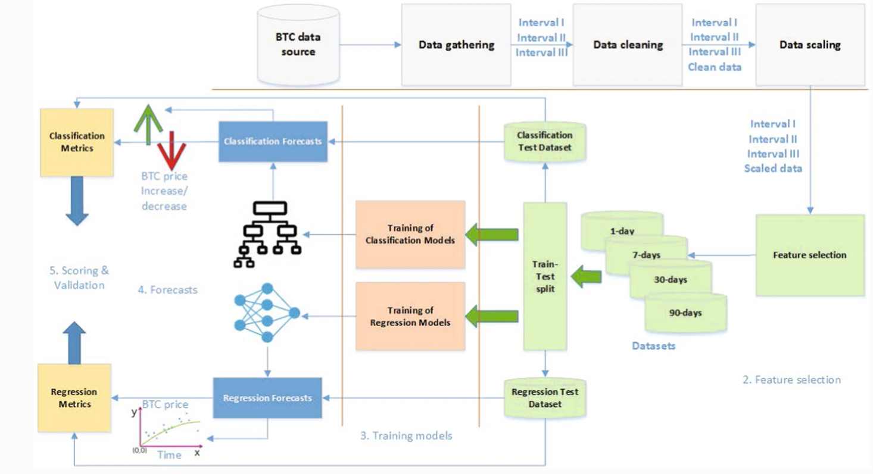
Process Flow

Slide 8

APPLICATION
1.Private traders who want to receive hints from the system of artificial intelligence and a forecast on the trend of cryptocurrency prices.
2.Professional companies that need to evaluate a comprehensive forecast for the whole real-time cryptocurrency market, portfolio management, investments, risk management, etc.

Slide 9
Timeline
16th July
25th July
October 20XX
30th July
`19th July
Project Registered
Team formed
Met our Supervisor
Jul |  |  |  |  |  |  |  |  |  |  | Sept
21st July
Idea of Crypto Currency Prediction based on Artificial Intelligence
First Review of the Project

Slide 10



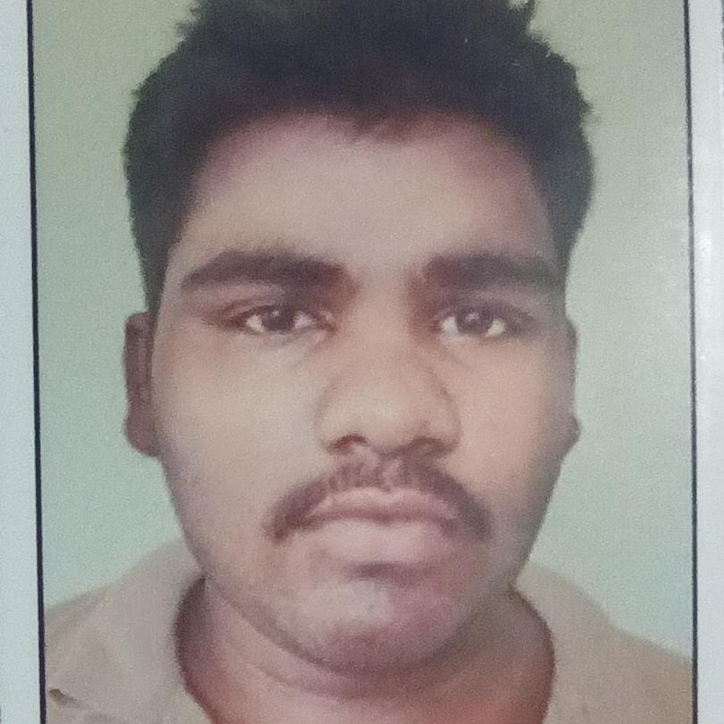
Contribution of each Member
Tanishq Kolhatkar
Sheikh Sameer
Varanasi Hemasai Reddy
Veera Venkata Vikas
Team Lead of the Project
Idea Of Project
Information gathered from Google
Stream Lite, Tenser flow,
Making of PPT
Information Gathered from Social media Platforms

